Slide 1



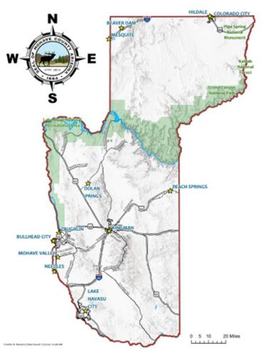


Mohave County
DIRECTOR’S MESSAGE
NEWSLETTER
Dear Mohave County,
We’ve just come off a long weekend celebrating Labor Day. For many, that extra day of rest was exactly what we needed—one more morning to sleep in, one more evening to spend with family, or one last chance to soak up the final rays of summer sunshine. Labor Day carries a symbolic weight: the sun is setting earlier, the warmest days are fading, and fall is just around the corner. It also reminds us that the holiday season is quickly approaching—only four more months until 2025 closes its eyes and 2026 begins to wake up.
But beyond backyard barbecues and last swims of the season, Labor Day holds a deeper meaning. It is a holiday dedicated to the American workforce—to the employees who power businesses of every size, and to the employers who provide opportunities, growth, and direction. It’s a moment to pause and recognize that the workplace is more than just a place where business gets done; it’s a community where people spend a significant portion of their lives.
For businesses, Labor Day also serves as a strategic checkpoint. This time of year, is perfect for asking important questions:
• Are we recruiting and hiring effectively?
• Is our onboarding process setting employees up for success?
• How are we doing on retention—are people staying, and if not, why?
• Are we providing enough training and cross-training to strengthen our teams?
• Do we have clear paths for employee advancement and growth?
These are not just HR questions—they are business questions. A company’s ability to thrive depends on the strength, skills, and satisfaction of its workforce. Employees who feel valued and supported are more likely to stay, grow, and contribute to long-term success.
For employees, Labor Day can be a gentle reminder that their hard work matters. It’s an invitation to rest, recharge, and return to work with renewed energy. It’s also a chance to reflect on their own career path: Where am I now? Where do I want to be by this time next year?
So, as we fold away the lawn chairs, pack up the picnic baskets, and look ahead to autumn routines, let’s carry forward the true spirit of Labor Day. Businesses can honor their teams not just with a holiday weekend, but with meaningful support and opportunities all year long. Employees can honor themselves by recognizing the value of their contributions and staying open to growth.
After all, work isn’t just about clocking in and clocking out—it’s about building futures, creating opportunities, and moving forward together.
Best Regards,
Tami
By Tami Ursenbach
September 2025

Slide 2




From the Desk
of Michelle
September is National Preparedness Month: Is Your Business Ready?
September isn’t just the month the weather starts to cool (a little) in Mohave County — it’s also National Preparedness Month, a nationwide effort to help communities and businesses get ready for the unexpected.
For small rural businesses, preparedness is more than just good planning — it can mean the difference between bouncing back quickly or closing the doors for good. Whether it’s a prolonged power outage, a supply chain delay, flash flooding, or even a wildfire, rural businesses face unique challenges. Longer emergency response times, limited backup suppliers, and smaller staff sizes mean being ready is critical.
Three Steps to Get Started This Month:
Know Your Risks – Identify the top threats in your area. In Mohave County, this might include monsoon storms, transportation disruptions, or extended power outages.
Protect Your Data & Operations – Back up records off-site or to the cloud, have a list of key suppliers and customer contacts, and make sure your insurance is up to date.
Create a Simple Continuity Plan – Write down who does what if your operations are disrupted. Even a one-page plan can save valuable time.
Small steps now can make a big difference later. Your business is a vital part of the local economy — and the community depends on you.
For more resources on creating a business preparedness plan, you can visit Ready.gov the official website of the U.S. Department of Homeland Security. Below is a Mohave County edition.
Small Business Preparedness Checklist (Mohave County Edition)
□ Identify top local risks (storms, outages, transportation delays)
□ Back up records off-site or to the cloud
List key suppliers and customer contacts
Review and update your insurance coverage
□ Create a one-page continuity plan
□ Train staff on emergency procedures
□ Prepare an emergency supply kit for your location

Slide 3
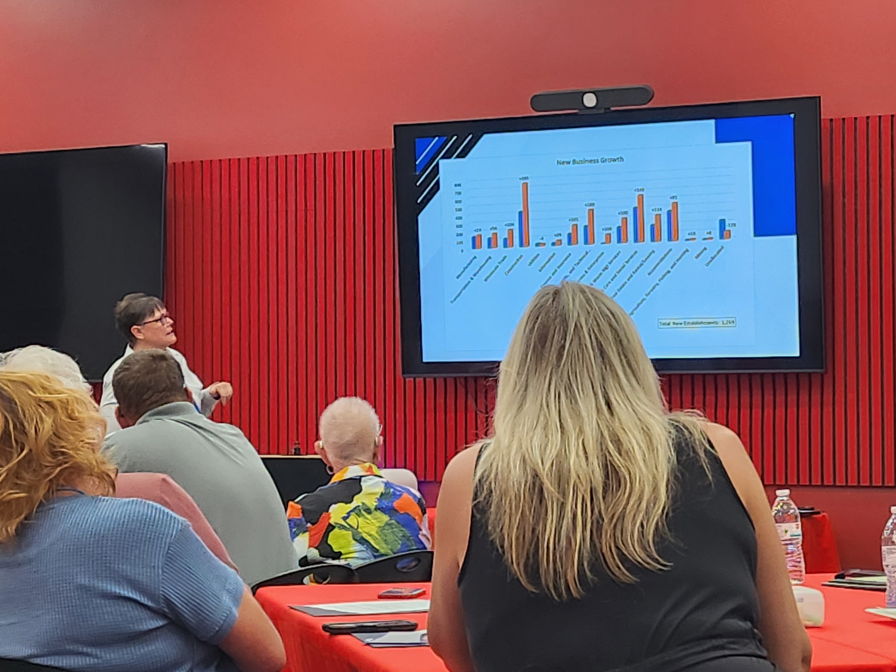

Regional Workforce Collaborative Meets at New Mohave College Training Center
By Michelle Loeber
On Tuesday, August 19, the Arizona Department of Education hosted a Regional Ecosystem for Workforce Development Collaborative meeting in Kingman, AZ. The gathering brought together educators, workforce and economic development professionals, city leaders, business leaders, and community stakeholders from across the region.
The meeting was held at the newly opened Mohave College Advanced Manufacturing Training Center, a state-of-the-art facility dedicated to preparing students for high-demand careers in advanced manufacturing.
Mohave County’s own Economic Development Director, Tami Ursenbach, was among a select group of presenters who shared insights on strengthening local workforce and economic initiatives.
Amy West, Superintendent of Western Arizona Vocational Education (WAVE), gave a presentation on its role as a Career and Technical Education District (CTED) serving students in Kingman, Lake Havasu, Bullhead, and Parker. WAVE provides career preparation for 10th–12th graders, and in some cases up to a year after graduation, through partnerships with local high schools, specialized training such as its Culinary and Hospitality campus, fire academies, and nursing assistant courses, and by covering tuition for programs at Mohave College and Arizona Western College in fields ranging from healthcare and law enforcement to business, welding, and HVAC. West also shared that WAVE is building a new training center in Kingman that will house both educational programs and regional workforce development partners, strengthening its mission to prepare students for life after high school through career readiness and post-secondary opportunities.
The day concluded with a dynamic roundtable discussion, where attendees explored potential solutions to enhance existing programs and expand the pool of skilled, job-ready workers across the region.
Newsletter
Each month, we provide helpful resources, ideas, trainings, and informative articles to support businesses in Mohave County.
We hope that businesses in the county will find this information useful or share it with companies that may benefit from it.
If your company needs specific assistance in any area, please feel free to contact:
Michelle Loeber
Phone: 928-757-0917
Email: loebem@mohave.gov
September Holidays
9/1 Labor Day
9/4 National Wildlife Day
9/7 Grandparents Day
9/18 U.S. Air Force Day
9/21 International Day of Peace
9/27 World Tourism Day

Slide 4

Remote Work Remains a Key Priority for U.S. Employees
By Beatriz Soto
Recent research highlights that many American workers aren’t ready to give up the flexibility of remote or hybrid work. About half of employees in these work arrangements say that a mandatory return to the office would likely prompt them to look for new opportunities. This underscores how integral remote options have become to employees’ routines and work-life balance.
Telework is on the rise: 17.9% of U.S. workers teleworked at least part-time in October 2022, rising to 23.7% by February 2025, according to the U.S. Bureau of Labor Statistics (BLS). While media narratives suggest a widespread push back to in-person work, data indicate that hybrid arrangements continue to grow steadily.
Understanding who benefits from remote work can guide employers in recruiting and retention strategies. Key groups include:
Caregivers and parents: 27.8% of workers with children under 18 telework some or all of the time. Remote arrangements help them balance professional responsibilities with family needs, often boosting productivity and engagement.
Younger and nontraditional workers: Digital nomads and adults living in multigenerational households often prioritize flexibility over traditional career paths. Embracing these workers can expand talent pools and enhance loyalty.
Employees with disabilities: Remote work removes commuting and accessibility barriers, allowing for greater independence, improved mental health, and more consistent engagement.
Employers who want to retain and attract talent in this evolving labor market can benefit from policies that support flexibility. Adjustments to leave programs, work schedules, and total rewards—such as transportation stipends or occasional onsite perks—can strengthen employee loyalty and satisfaction.
As talent shortages and market shifts continue, remote and hybrid workers represent a vital resource. By fostering adaptable and inclusive work policies, companies can secure their workforce today while preparing for the talent needs of tomorrow.

Slide 5
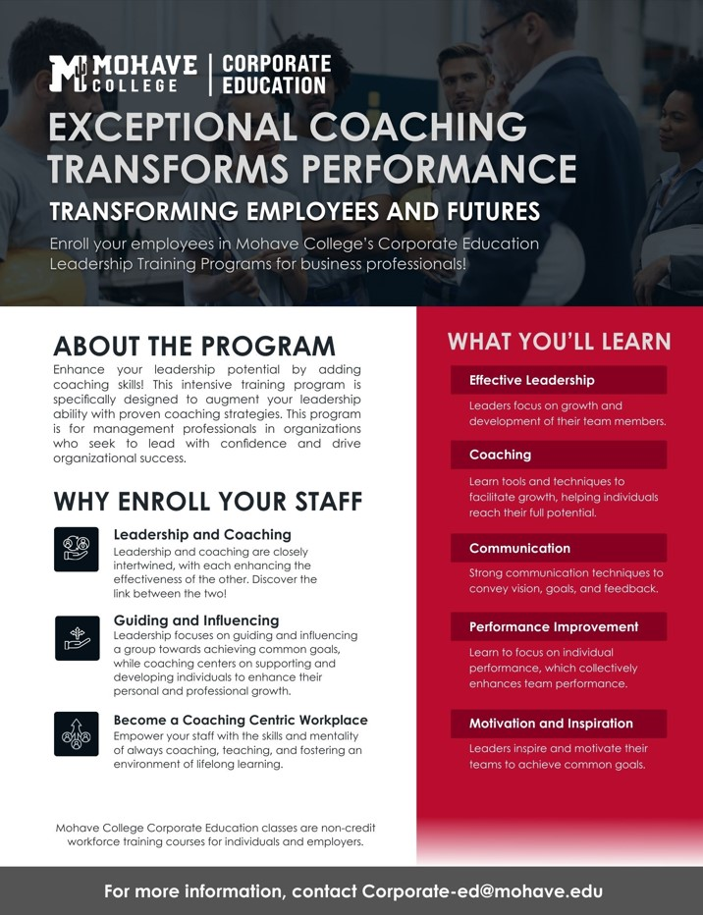

Slide 6
Mohave College Defies National Trends with Strong Year-Over-Year Growth
By Tami Ursenbach
Across the nation, community colleges have faced serious challenges in the years since the COVID-19 pandemic. Since 2020, 45 colleges have closed, more than 35 have merged with nearby institutions, and many others are struggling to attract students. Declining enrollment, funding pressures, and shifting workforce demands have forced institutions to make difficult decisions about their futures.
Amid these challenges, Mohave College is standing out as a success story. Rather than scaling back, the college has embraced bold changes to position itself for long-term growth. Over the past year, Mohave College has implemented a strategic vision that includes a new name and branding, the launch of bachelor’s degree programs, and major investments in campus infrastructure. Each of the four campuses is undergoing construction and revitalization projects designed to better serve students, support local communities, and prepare for the future workforce.
These forward-looking steps are already paying off. While many community colleges are shrinking, Mohave College has seen consistent year-over-year enrollment growth:
Fall 2024 enrollment increased by 17% compared to Fall 2023, reaching 4,656 students.
Spring 2025 enrollment is up nearly 10% compared to the previous spring.
Unduplicated headcount rose more than 10% between fiscal years 2022–23 and 2023–24, while Full-Time Student Equivalents (FTSE) increased by 9.5%.
Credit hours grew by 9.2% year-over-year, with total student enrollment climbing 11% in the same period.
These numbers highlight how Mohave College is bucking national trends by focusing on innovation, student needs, and regional workforce opportunities. By offering new degree pathways, strengthening partnerships, and reinvesting in modern facilities, the college is creating an educational environment that attracts students and supports long-term community development.
Looking ahead, Mohave College is poised for even greater impact. With the new Advanced Manufacturing Training Center opening last month, the college is expanding its ability to train students for high-demand, high-paying careers in modern industries. This state-of-the-art facility will serve as a cornerstone for future growth and ensure that Mohave College continues to meet the evolving needs of employers and students alike.
In an era when many community colleges are closing their doors, Mohave College is thriving—growing double digits year over year and building momentum for the future.

Slide 7

Economic Development Update
By Tami Ursenbach
On August 18th, the Economic Development Department delivered a presentation highlighting recent progress and future priorities. Following the meeting, many community members requested that some of the slides and key information be shared.
Strategic Focus for our Department was shared including:
Provide resources to new and existing businesses
Prioritize and align education for a skilled workforce
Identify and build out critical infrastructure
Expand tourism and film initiatives
Develop partnerships with local agencies to further these efforts
We were excited to share a growth snapshot from January 2019 – December 2024
Our county continues to experience strong and steady growth:
Population growth rose +19,279 residents
Income Increased in both Personal incomes rose by $10,466; median household income rose by $14,299
Labor Force Growth showed an additional +5,343 employees
New business establishments showed a net 1,269 new businesses with many small businesses and start-ups.
Zero-Based Budget Goals show we are on track for the year.
As part of our Zero-Based Budget commitments, Economic Development staff pledged to meet with 240 companies between July 2025 and June 2026. Early findings show that the greatest need is skilled labor.
To help address this, our office is offering FREE trainings in manufacturing and construction to strengthen the local workforce. We also offer FREE training and resources for other businesses. Our team is here to support businesses through both challenges and successes. Services may include:
Marketing
Human resources
Leadership
Financial guidance
Workforce development
Inventory control
Safety

Slide 8
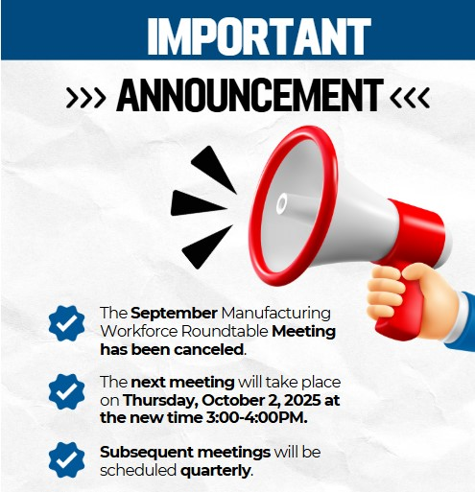

10 Resources to Help Rural Entrepreneurs
Center for Rural Affairs - Focused on building a stronger rural future by fostering community, justice, stewardship, and opportunity through active engagement.
Center on Rural Innovation - Works with rural leaders to expand entrepreneurship, innovation, and tech jobs so everyone can benefit from the growing tech economy.
e2 Entrepreneurial Ecosystems - helps communities thrive by connecting them to share best practices for building sustainable entrepreneurship.
Rural Business-Cooperative Service - A USDA program that supports rural residents with funding, training, and education to create jobs and grow businesses.
Rural Ideas Network - A free community for rural entrepreneurs offering tools, resources, networking, and peer learning opportunities.
Investing in Rural Prosperity – Features contributions from 79 authors covering various topics, including support for entrepreneurs.
Resources for Rural Entrepreneurs: A Guide to Planning, Adapting, and Growing Your Business – Guide from the USDA on how rural entrepreneurs can use the federal agency and other federal programs to access financing and other assistance to start and expand their business.
Promoting Rural Entrepreneurship and Rural Economic Development – Discusses rural entrepreneurs’ economic challenges and the various approaches to solve them.
Rural Entrepreneurship: Lessons Learned from Ecosystem Building in Oregon – A nine-lesson PDF to help rural entrepreneurs thrive.
University of Wisconsin Extension Program - a free webinar series on Tips for Food and Farm Business Success.

Slide 9

The Rise of “Job Hugging”: What It Means for Employers
By: Tami Ursenbach
For much of the last decade, employers faced constant turnover as job hopping became the norm. Workers—especially younger generations—often left for even small pay increases, leaving organizations scrambling to fill gaps. That cycle is slowing. A new workplace trend known as “job hugging” is gaining traction, as employees are choosing to stay in their roles longer rather than chase marginal gains elsewhere.
For employers, this shift brings both relief and responsibility. On one hand, lower turnover means reduced hiring costs, fewer disruptions, and stronger institutional knowledge. Teams can maintain continuity, and companies can invest in long-term training with greater confidence that employees will remain to apply those skills. In an environment where recruitment expenses and onboarding time can be substantial, retaining employees offers significant savings.
On the other hand, stability doesn’t mean complacency. Workers are staying in part because the financial rewards of switching jobs have diminished, but they still expect meaningful work, career development, and a positive culture. Employers who see this as an opportunity to deepen engagement rather than take loyalty for granted will reap the biggest benefits. Investing in clear career pathways, internal mobility programs, and supportive leadership can turn “job hugging” into a strategic advantage.
This trend also challenges employers to rethink retention strategies. In the past, pay raises were the primary tool to prevent departures. Now, flexibility, professional growth, and workplace culture are equally important levers. Companies that provide these elements are more likely to build long-term employee loyalty—and avoid the hidden risks of disengagement that can come when workers feel “stuck” instead of “supported.”
The era of constant turnover is giving way to the Big Stay. For employers, the message is clear: job hugging isn’t just about workers holding on—it’s an opening to build a more stable, committed, and productive workforce.

Slide 10

Roaming
Cactus
Each month, we will feature a different area of the County or a point of interest. Our goal is to inspire you to visit these locations and promote them to travelers beyond our area. Together, we can boost tourism and showcase the beauty of Mohave County!
Willow Beach, Arizona: The Southwest’s Hidden Oasis of Adventure and Tranquility
By Tami Ursenbach
If you're looking for your next unforgettable getaway, pack your bags and set your sights on Willow Beach, Arizona—a jaw-dropping natural oasis tucked along the Colorado River just 45 minutes from Las Vegas. With its emerald waters, mystical hot springs, and epic desert landscapes, this slice of the Southwest is nothing short of magical. Whether you're craving heart-pounding adventure, peaceful escapes into nature, or one-of-a-kind photo opportunities, Willow Beach is the destination that delivers it all.
Imagine launching a kayak from the serene harbor of Willow Beach, the water crystal-clear beneath your boat as you glide through towering canyon walls. Just two miles upstream, you’ll enter the spellbinding world of Emerald Cove, where the sunlight reflects off the water in a brilliant green glow that feels almost otherworldly. This breathtaking spot is only accessible by water, making the journey itself part of the adventure. As you paddle, keep an eye out for bighorn sheep scaling rocky cliffs or bald eagles soaring overhead—nature puts on quite the show out here.
For the explorers at heart, Willow Beach is also the gateway to the legendary Arizona Hot Springs. The hike to reach them winds through volcanic rock formations and narrow slot canyons, creating a true desert adventure before rewarding you with a series of natural pools heated by geothermal energy. You’ll climb a 20-foot ladder and follow a creek through a dramatic canyon, finally arriving at the hidden springs where you can soak your worries away, surrounded by nothing but the sights and sounds of nature. It’s a surreal, soul-soothing experience you’ll never forget.
Back at the Willow Beach Marina, life moves at the perfect pace. Rent a pontoon boat for a lazy river cruise, cast a fishing line into the cool, deep waters, or enjoy lunch at the Willow Beach Grill as the sun dances on the water. The marina has everything you need to fuel your day of discovery, from equipment rentals to snacks and souvenirs. Whether you're an experienced outdoors enthusiast or simply in search of beauty and peace, Willow Beach rolls out the welcome mat with style.
Best of all, this incredible destination is accessible year-round, though spring and fall offer the most comfortable weather for hiking and paddling. And when you visit, you're not just seeing nature—you’re living in it. The contrast of sparkling waters against dramatic desert cliffs is pure cinematic magic, and it’s no wonder so many adventurers return year after year.
So don’t just dream about your next vacation—make it unforgettable. Discover Willow Beach, explore the emerald wonder of the cove, hike into the wild to soak in ancient hot springs, and experience the raw beauty and energy of Arizona’s best-kept secret. This is not just a trip. It’s a memory in the making.

Slide 11


Tourism Meeting Notes
August Regional Tourism Meeting cancelled – Next meeting scheduled for September 18, 2025
Email Beatriz Soto at sotobe@mohave.gov to RSVP.
Continues next page

